Slide 1
Network Development with STM32 Based Control System

Slide 2

Objectives
Overview
What is Microcontroller
Microcontroller Evolution
Application of Microcontroller
Recent Market Trend
Trend in Microcontroller Market
Career in Microcontroller
STM32 Microcontroller
Project Lifetime
Goal
Challanges
Collaboration
Reference

Slide 3

Study and work on STM32 Microcontroller
Firmware development (register level programming)
Network establishment thorough protocol

Slide 4
Overview

Slide 5
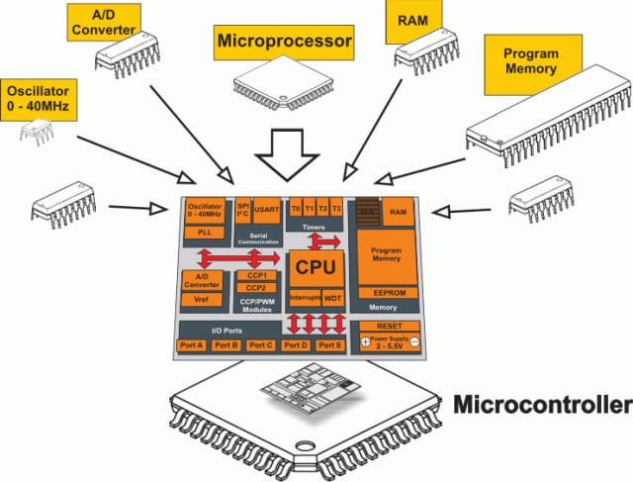
What is Microcontroller?

Slide 6
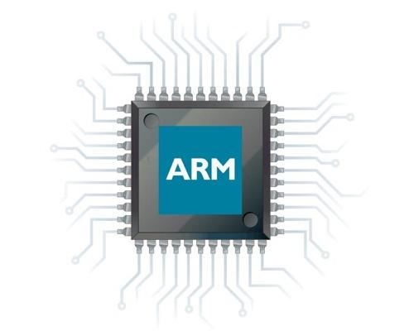
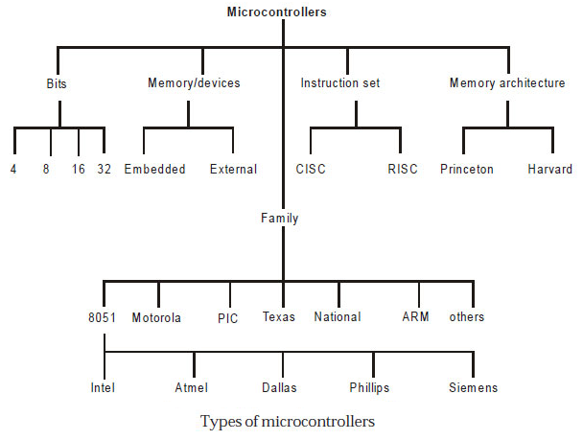
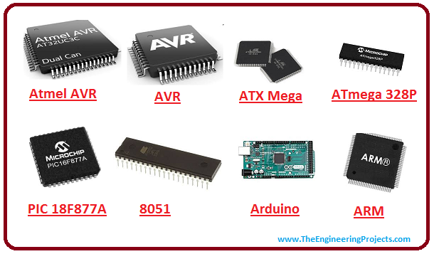
Categories of MCU

Slide 7
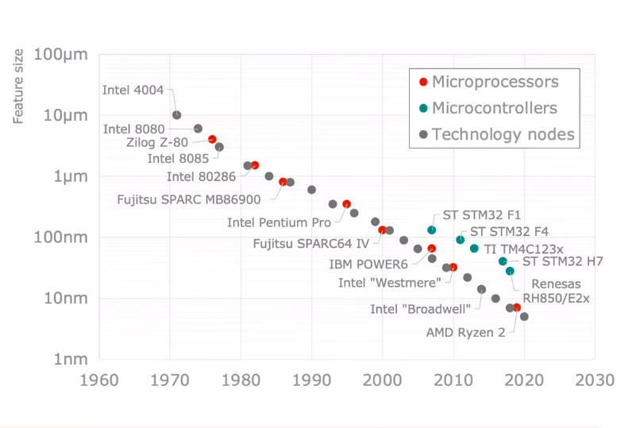
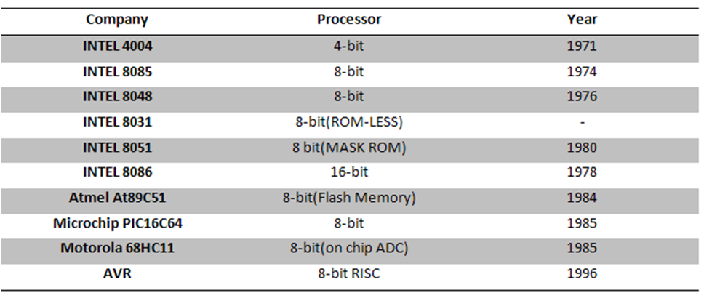
Microcontroller Evolution
Launched 2007
Microcontroller follow the main semiconductor technology trend
Figure-MCU Evolution[9]
The key requirements today
low power consumption
high integration density
Figure-MCU Evolution [8]

Slide 8
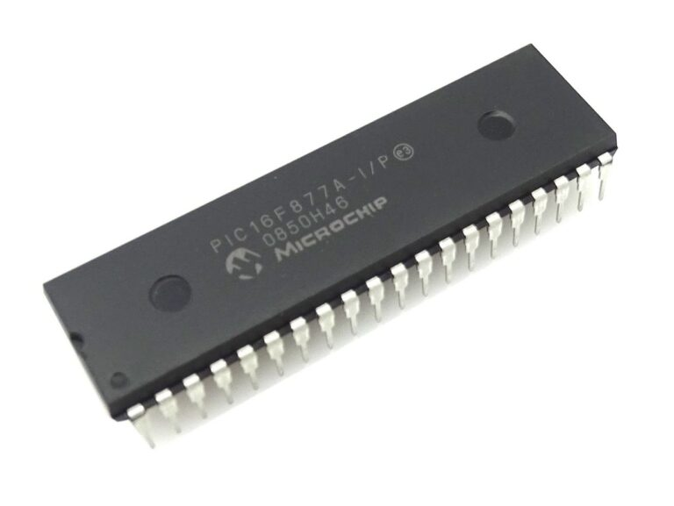
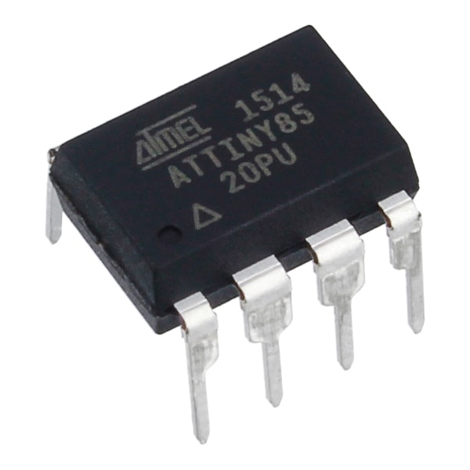
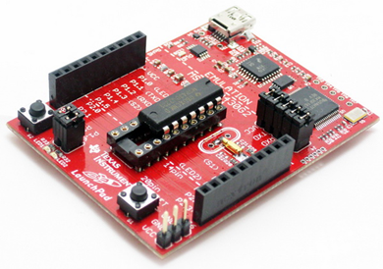
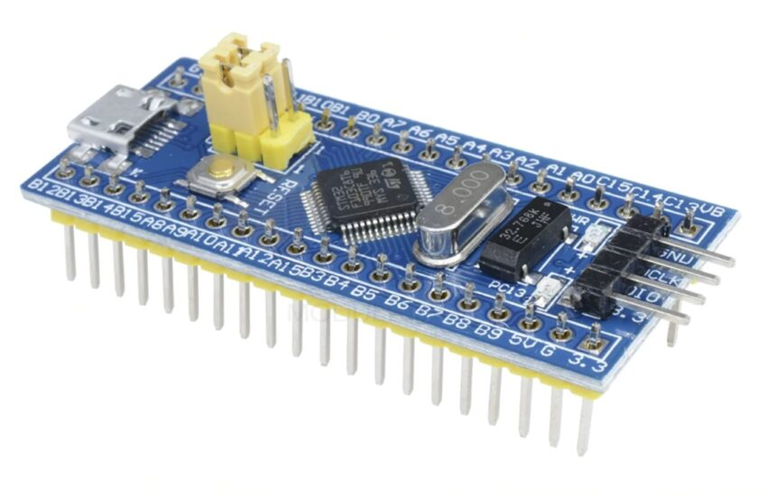
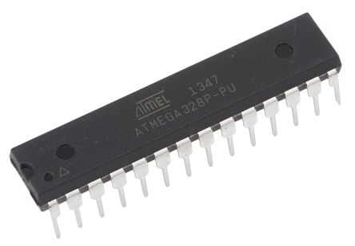
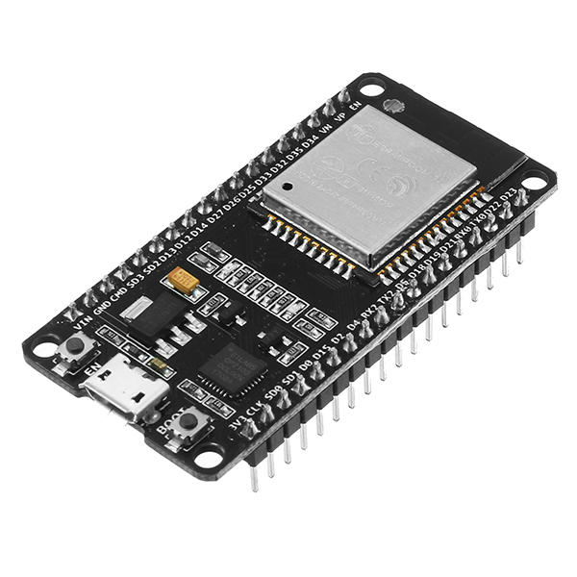
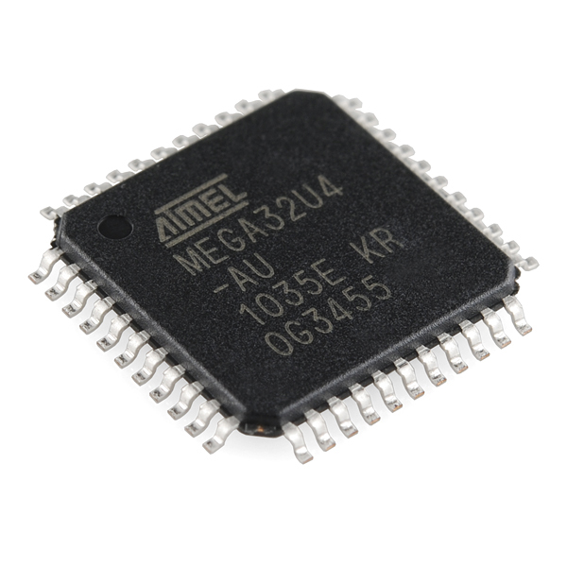
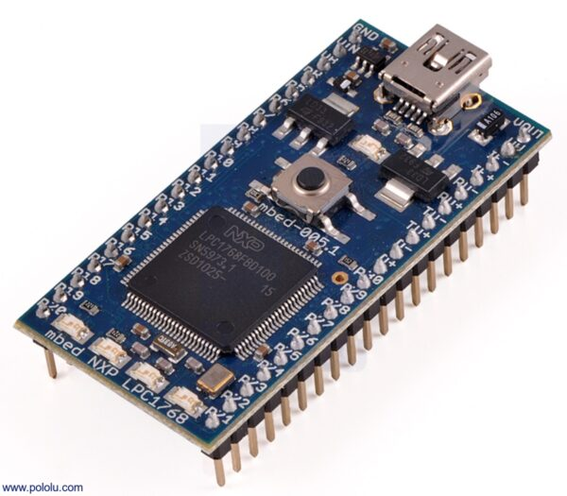
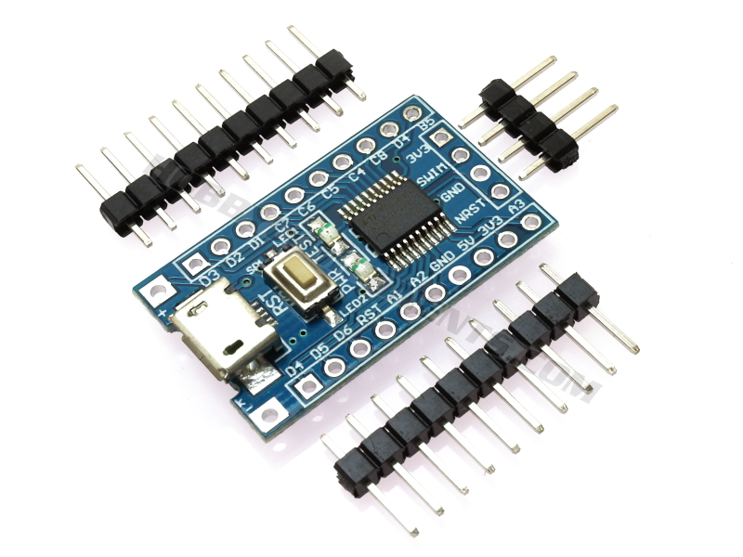
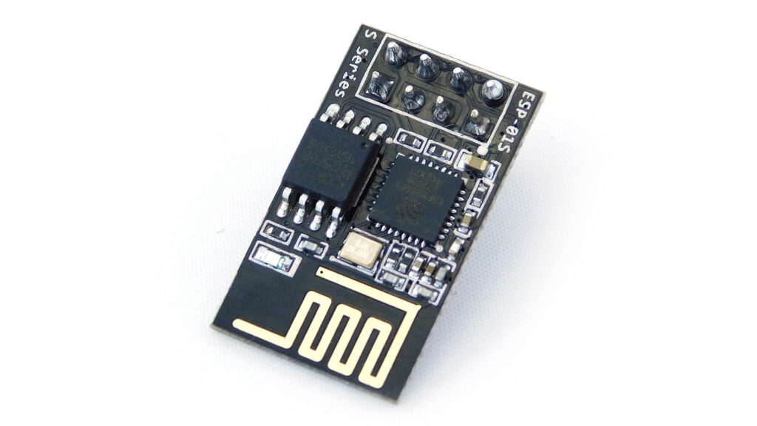
Several Microcontrollers of recent time
Figure-STM32F103C8T6
Figure-ATmega328
Figure- PIC16F877A
Figure- Attiny85
Figure- MSP430G2452
Figure- ESP8266
Figure- ESP32
Figure- ATMEGA32U4
Figure- ATMEGA32U4
Figure- NXP LPC1768
Ref: [3]

Slide 9
Several Microcontrollers of recent time
Figure-STM32F103C8T6
Figure-ATmega328
Figure- PIC16F877A
Figure- Attiny85
Figure- MSP430G2452
Figure- ESP8266
Figure- ESP32
Figure- ATMEGA32U4
Figure- ATMEGA32U4
Figure- NXP LPC1768
Ref: [3]

Slide 10
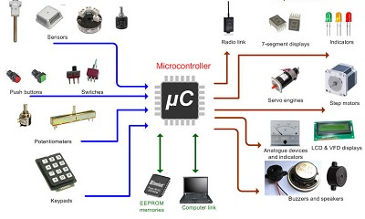
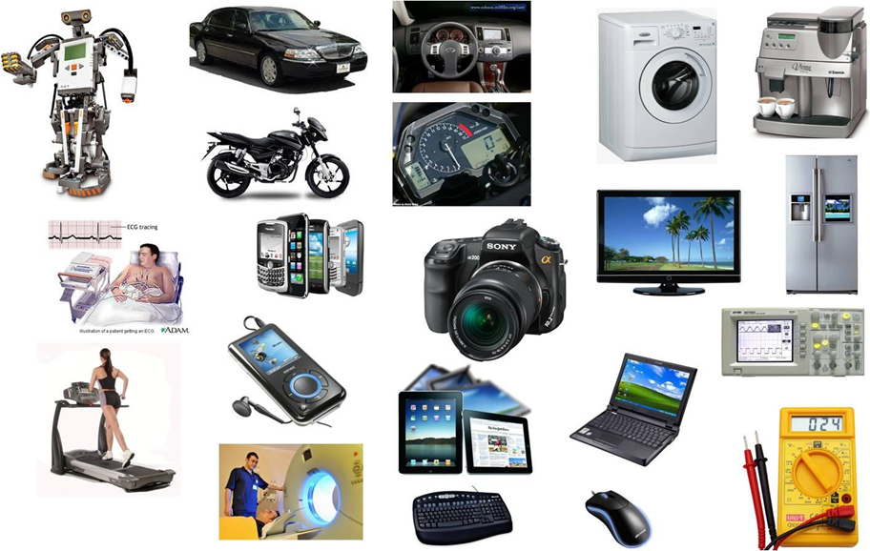

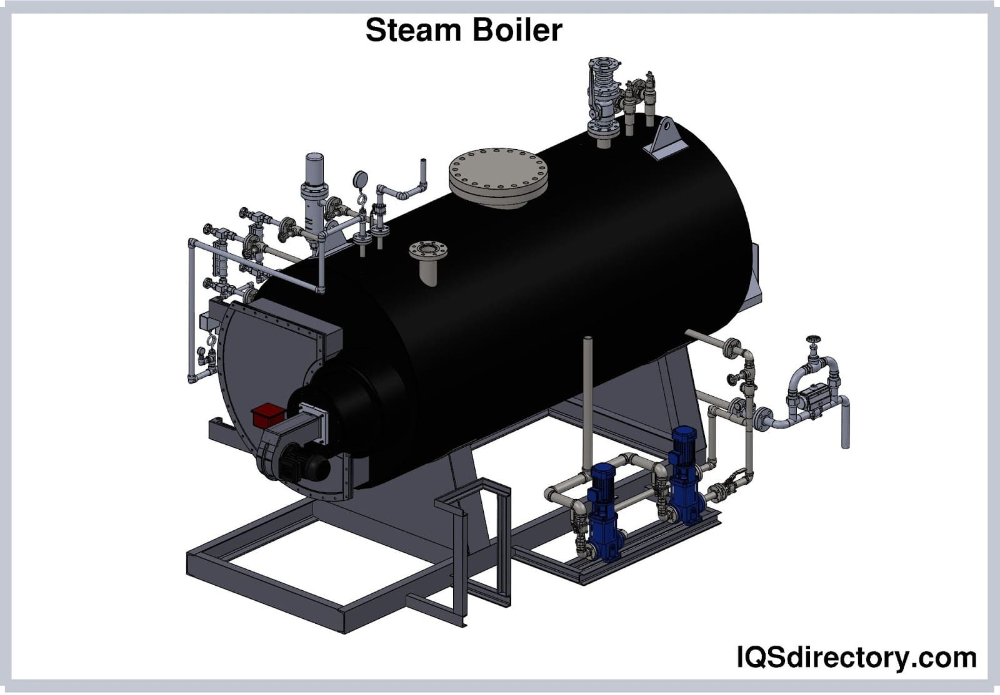


Where we don’t use microcontroller?
Notes:
I phone 13 chipser is Apple A15 Bionic ,mursalin will present next slide from here

Slide 11
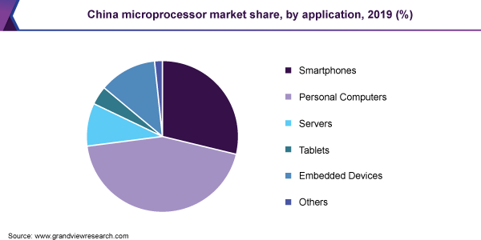
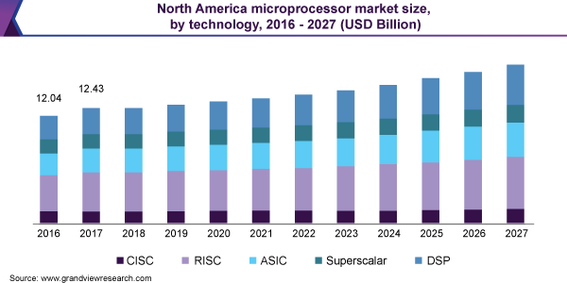
Recent Market Trend
The latest processors are improving every aspect of performance and efficiency.
Figure-Processor Market in China [3]
As much as they are getting faster, they are also more energy-efficient and reliable.
Figure-Processor Market in NA[2]

Slide 12
Recent Market Trend
The latest processors are improving every aspect of performance and efficiency.
12.43 B
Figure-Processor Market in China [3]
As much as they are getting faster, they are also more energy-efficient and reliable.
Figure-Processor Market in NA[2]

Slide 13
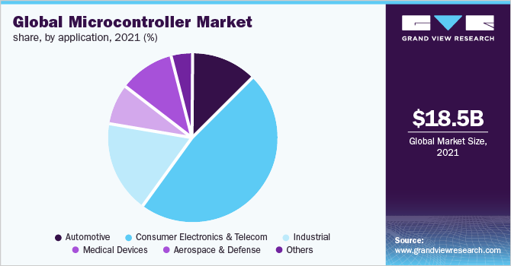
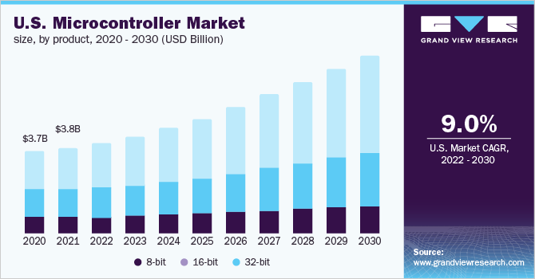
Trend in Microcontroller Market
There is a trend of increasing market size and value of microcontroller in recent year.
Figure-Global Market of MCU [5]
Figure-MCU Market in US[4]

Slide 14
Trend in Microcontroller Market
There is a trend of increasing market size and value of microcontroller in recent year.
3.8 B
Figure-Global Market of MCU [5]
Figure-MCU Market in US[4]

Slide 15
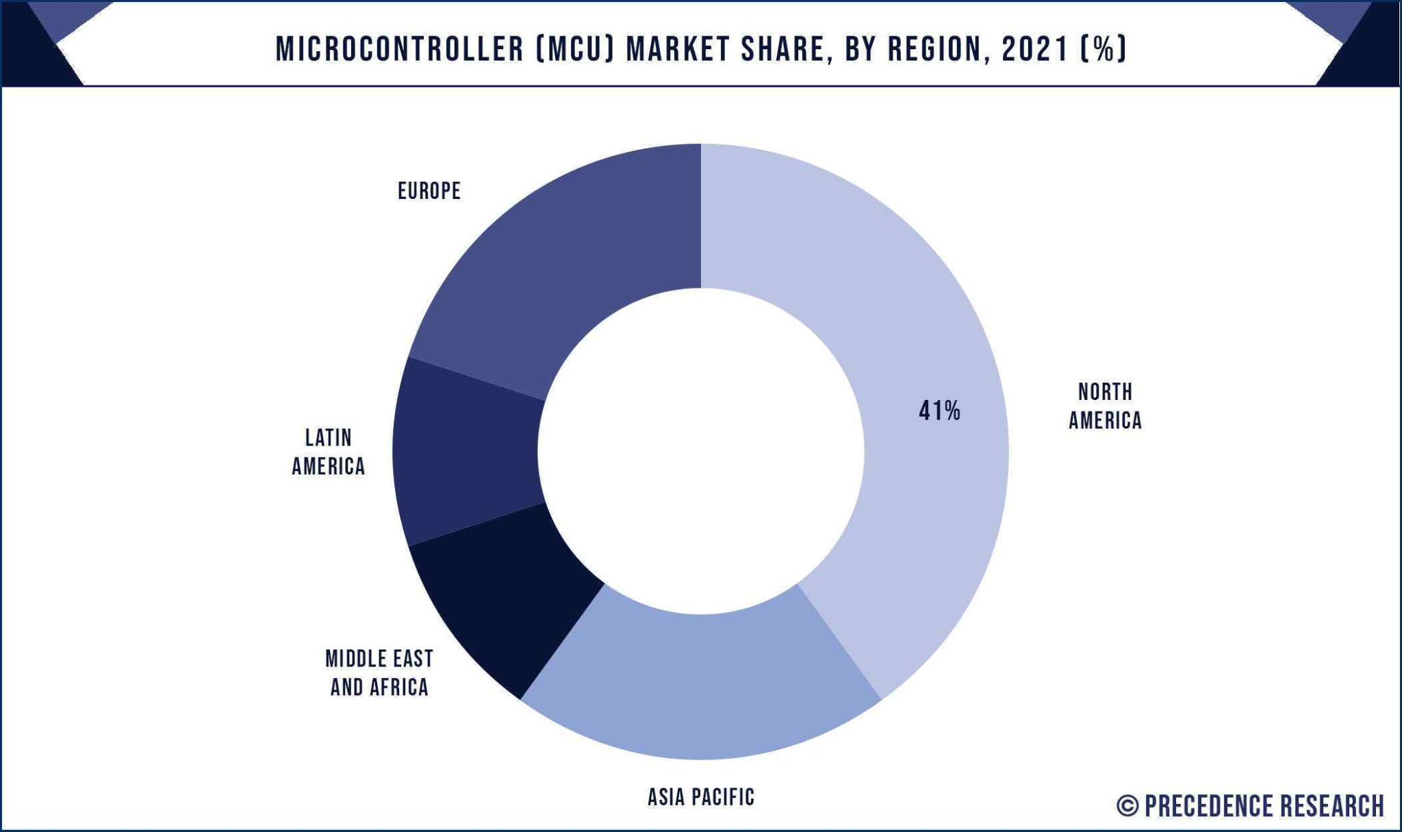
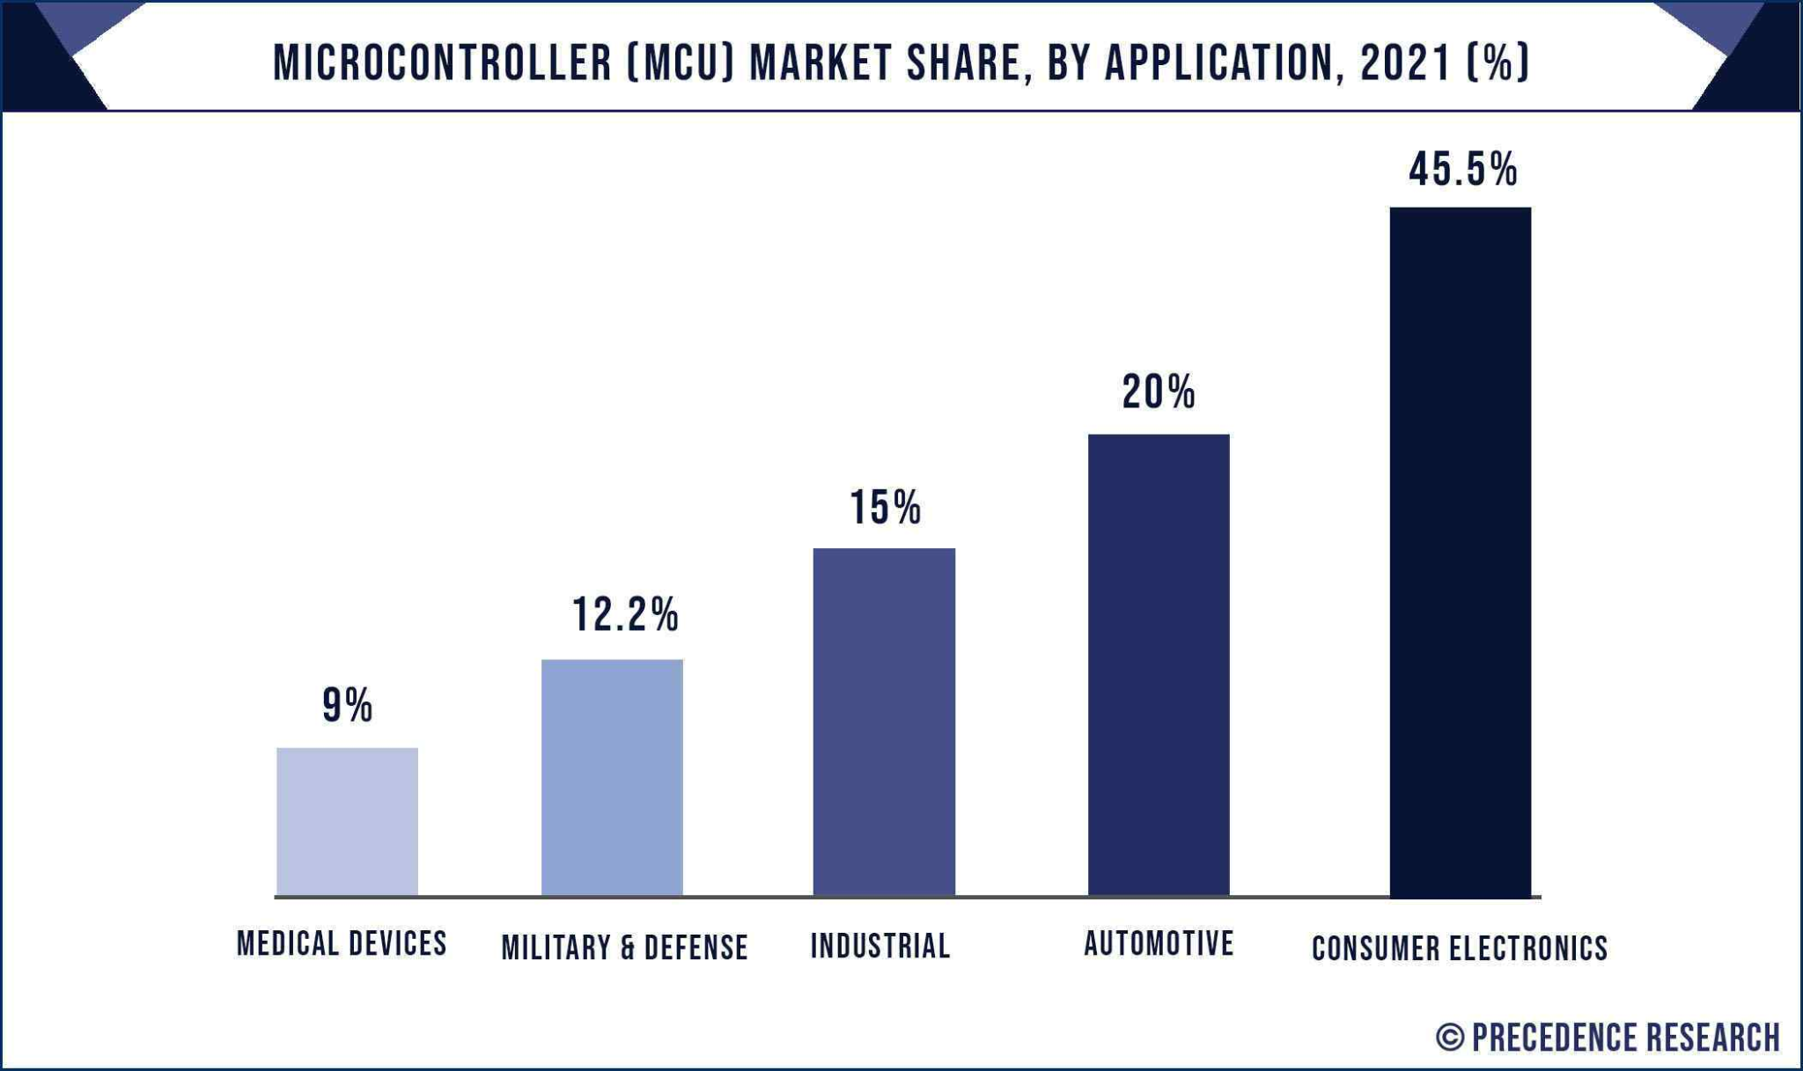
Career in Microcontroller
In STM32 90% is of programming and only 10% of hardware working.
Figure-MCU Market Share[7]
Due to growth of market size, many job opportunities is are created every year.
Figure-MCU Market Share[6]

Slide 16
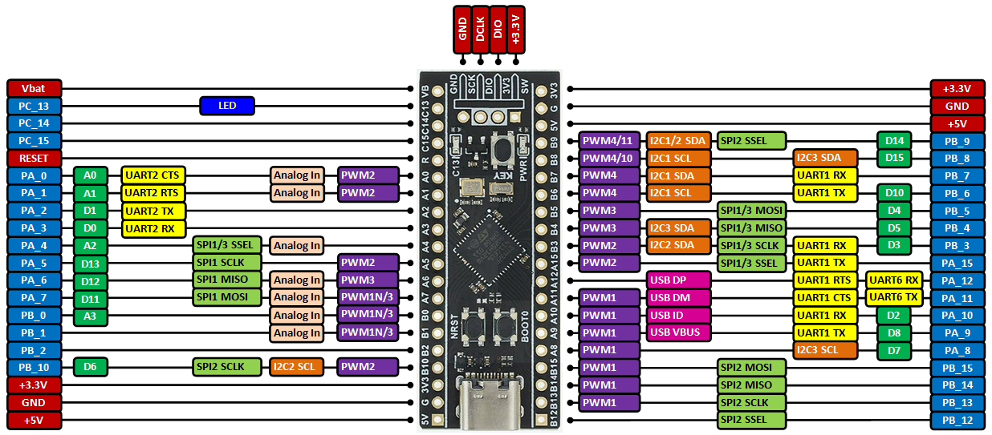
The STM32F401 Microcontroller
Figure - STM32F401CC6 pinout
Size: 3 x 3 mm.
Key Feature: Cortex®-M4 core with floating point unit, running at 84 MHz.
Performance: It delivers 105 DMIPS/285 CoreMark performance.
Ref: [1]

Slide 17
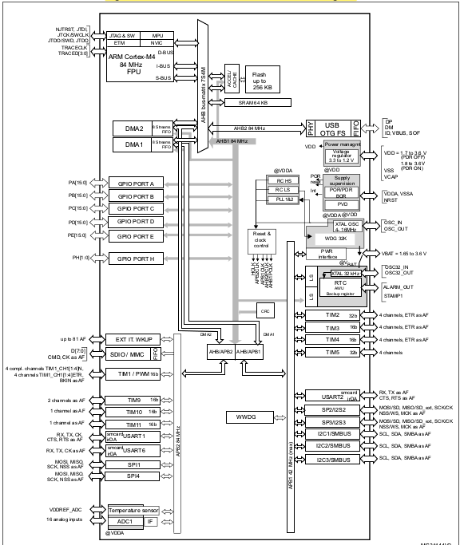
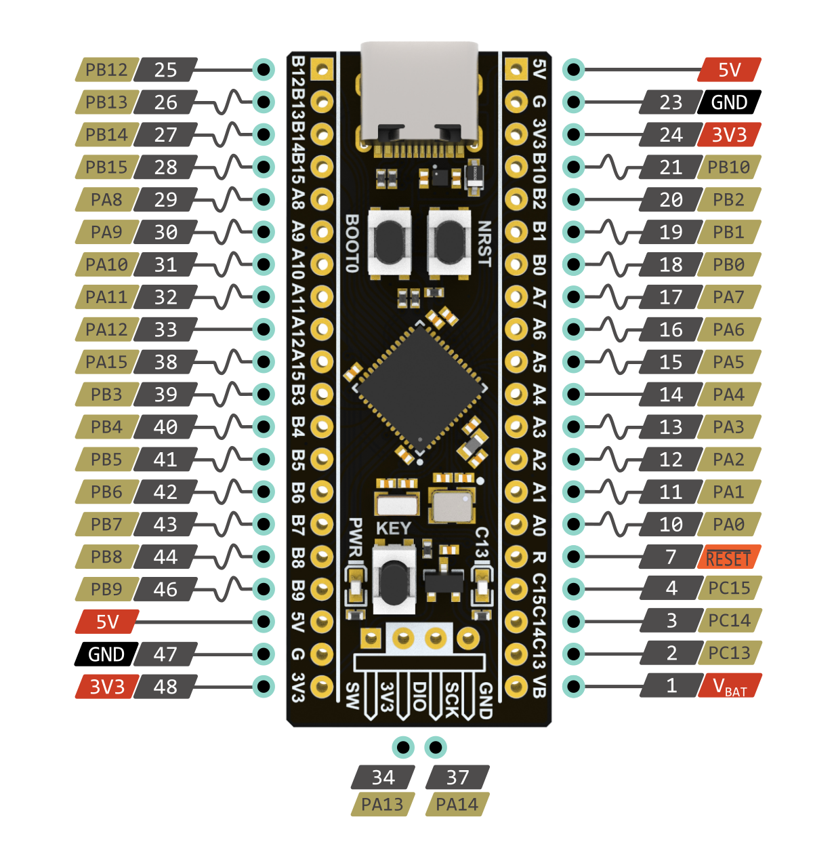
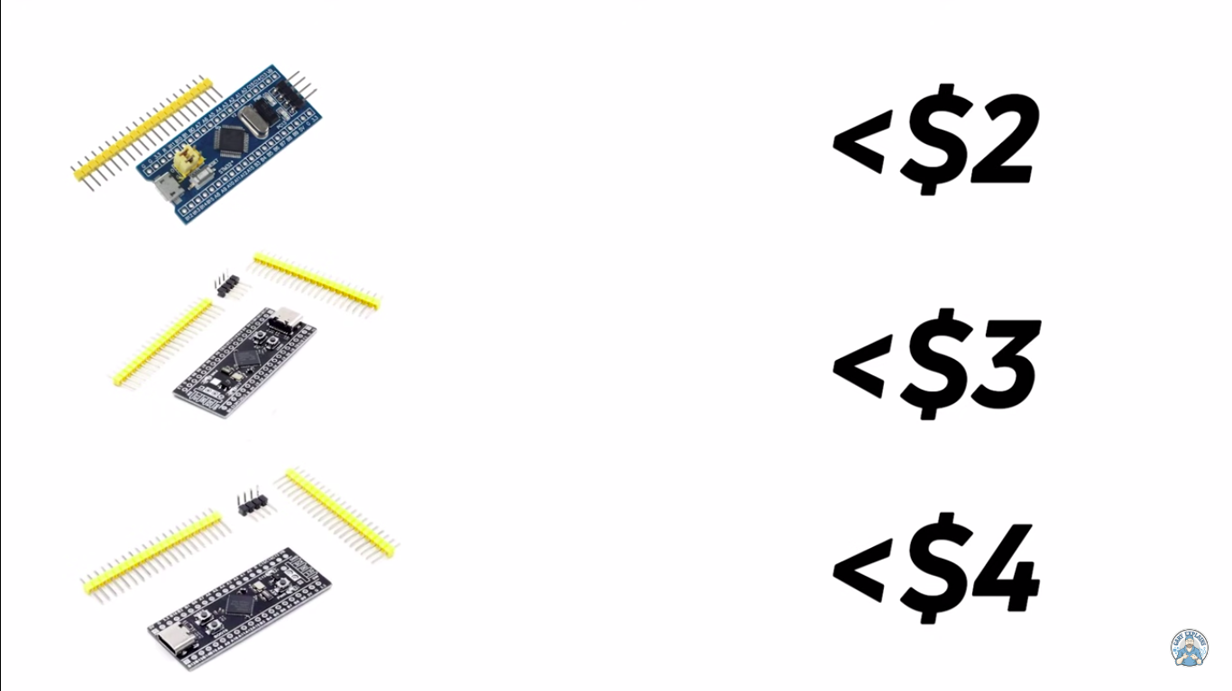
The STM32F401:
Figure- STM32F401xB/STM32F401xC block diagram

Slide 18
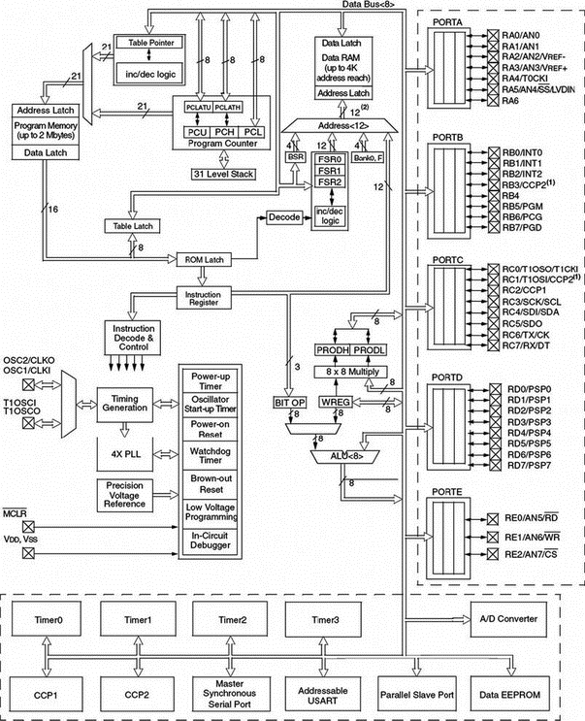
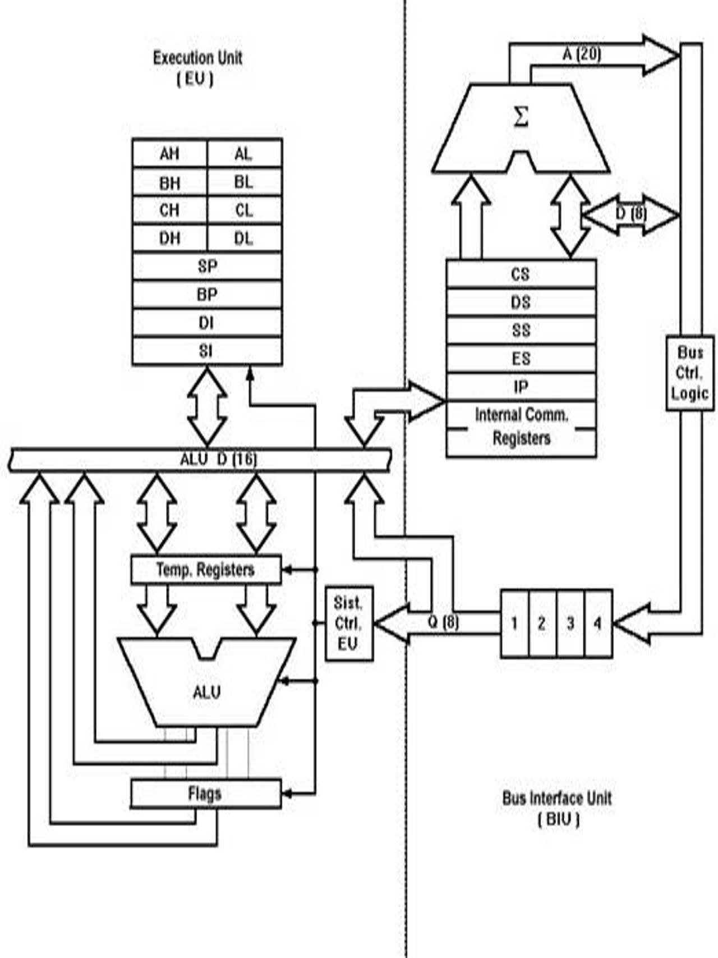
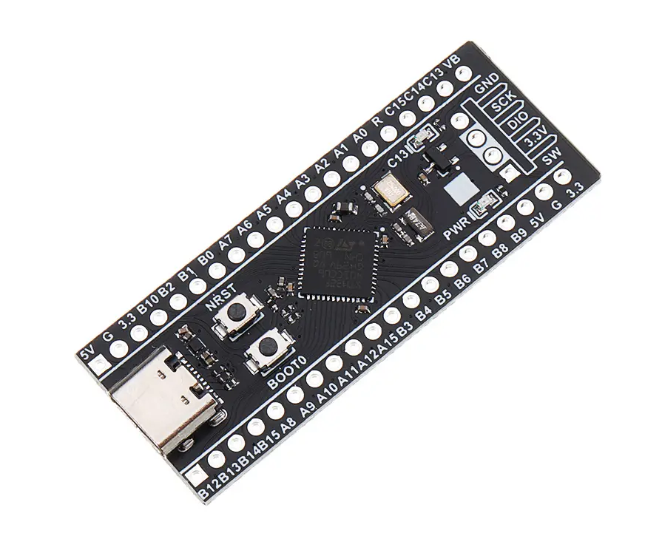
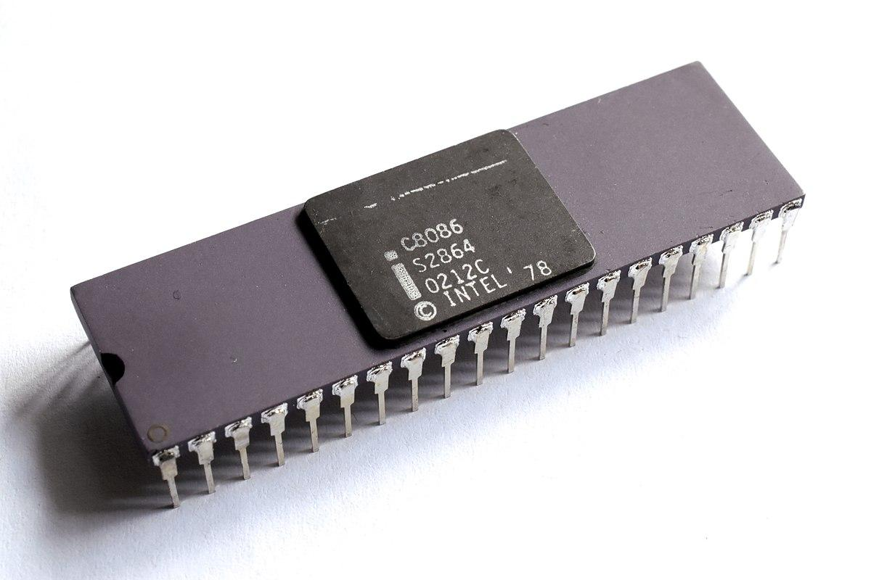
MCU
MPU
VS
Figure-architecture
Has ALU ,timing unit ,memory I/O port, timers, counters
Most of the pins are multifunctional
Low power consumption and cheaper
Has ALU and timing unit
Most of the pins are unifunctional
Higher power consumption and expensive
Figure-STM32f401
Figure-8086 MPU

Slide 19
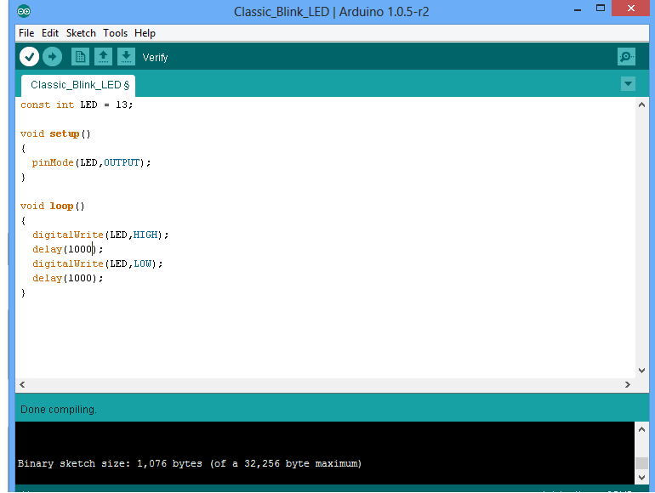
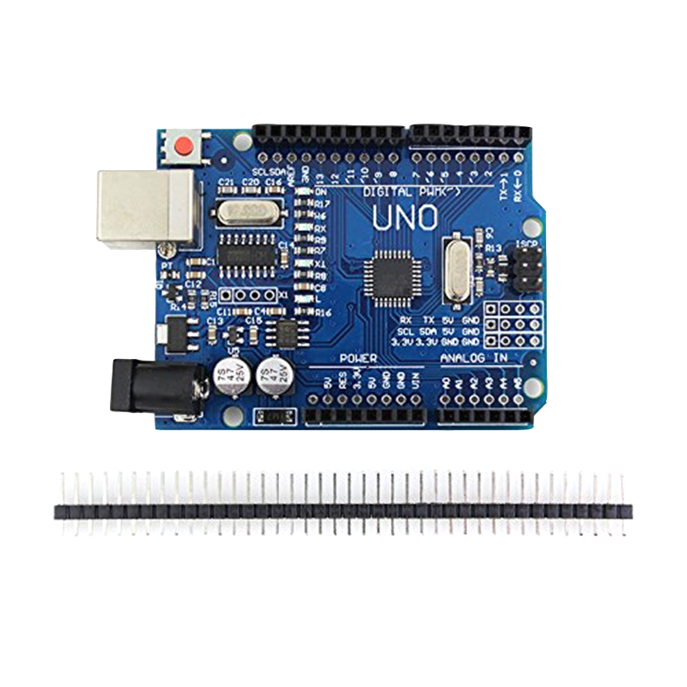
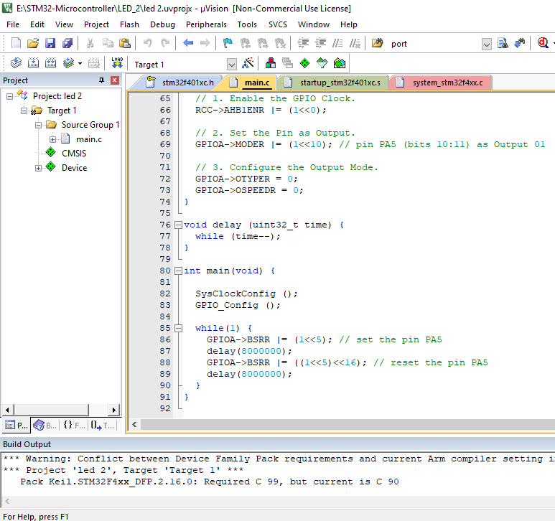
Arduino
vs
STM32
Arduino uses AVR-32 bit
Arduino have well-built libraries
Programed directly through USB
STM32 uses ARM-32b
Requires professional knowledge.
Programed through ST-Link

Slide 20
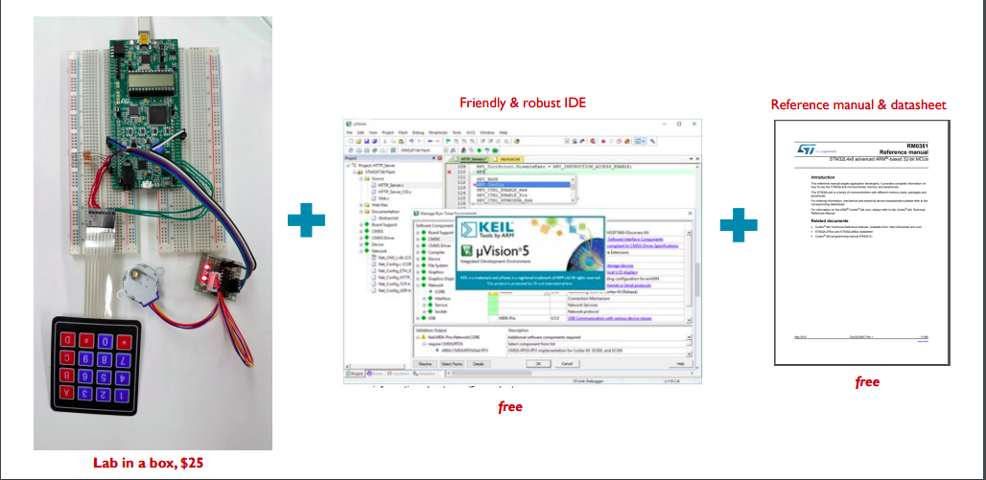
Structural Way of Programming in STM32
Ref: [2]

Slide 21
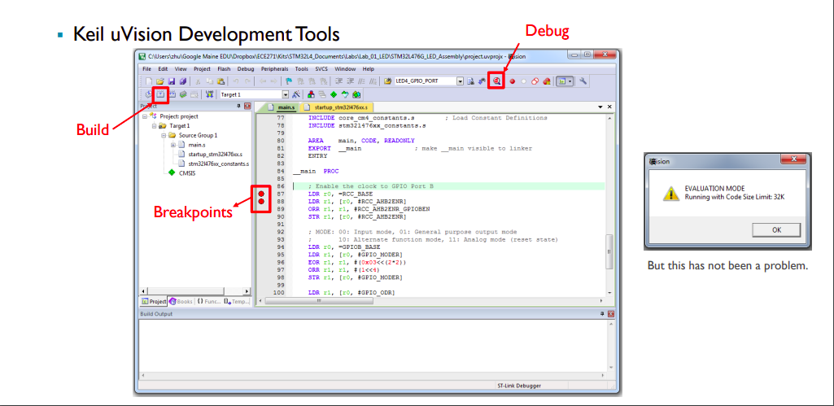
Structural Way of Programming in STM32
Ref: [2]

Slide 22
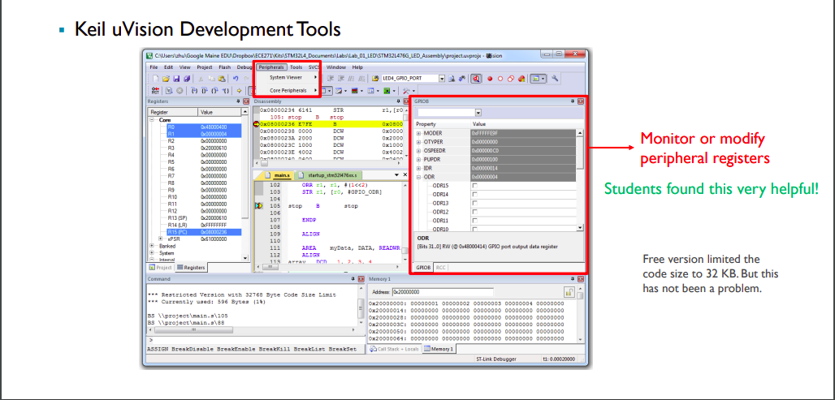
Structural Way of Programming in STM32
Ref: [2]

Slide 23
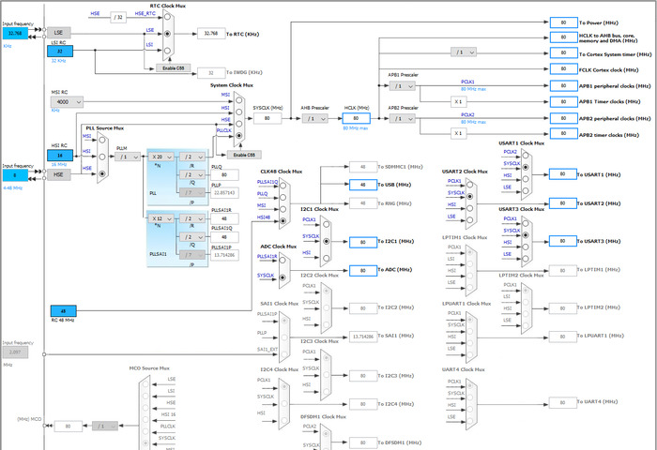
Structural Way of Programming in STM32
STM32CubeMX
Ref: [2]

Slide 24
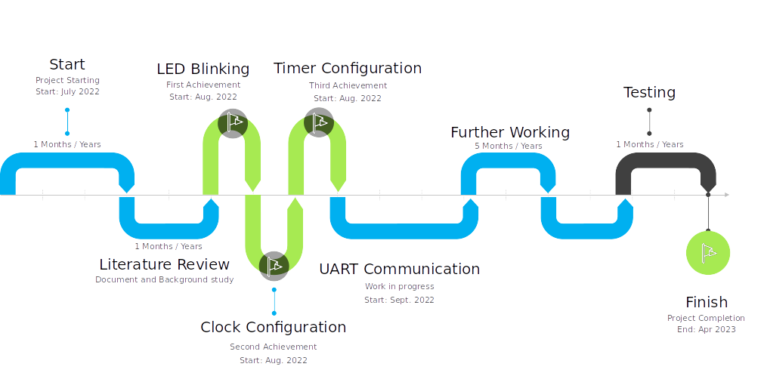
Project Lifetime

Slide 25

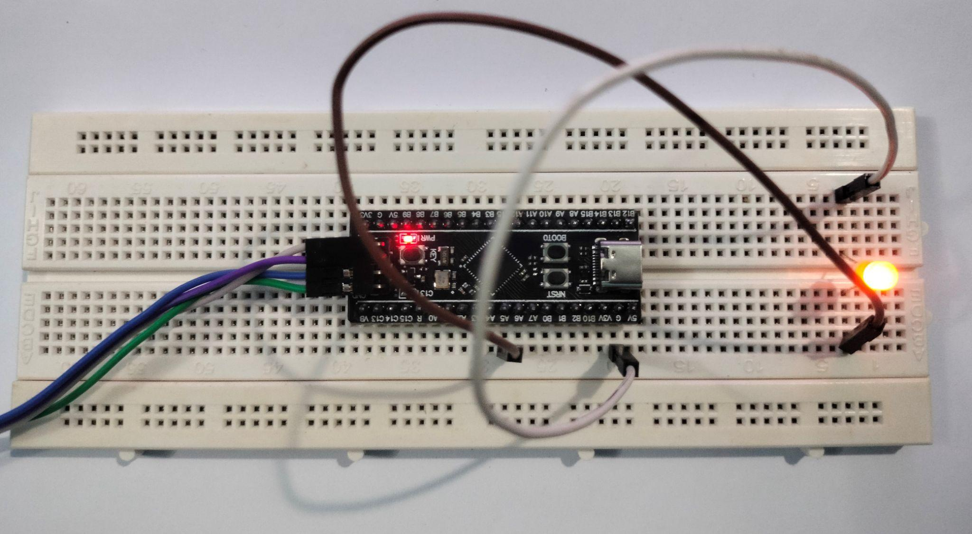
Achievements
RCC Clock Configuration and LED Blinking

Slide 26
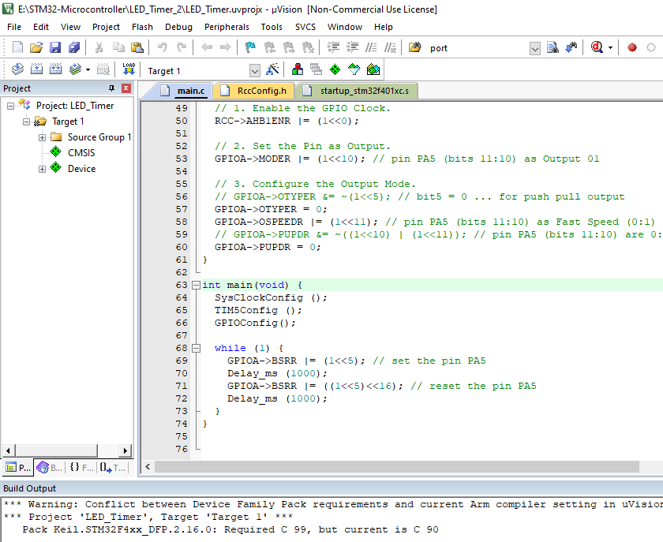
Achievements
Timer configuration with precise delay

Slide 27

Establish a network of microcontrollers based on network protocol (I2C/SPI/UART Communication)
Remotely connected microcontroller via server.
Further Goal: GUI based interface for better workings

Slide 28


New technologie with limited resources
Almost everything is manual working.
Official manual is huge and cumbersome.

Slide 29






Collaboration
Dr. Mosaddek Tushar
Professor
CSE, University of Dhaka
Syed Imtiaz Ahmed
President
Signal Stream Inc., Canada
Dr. Md. Ariful Islam Nahid
Professor
EEE, University of Rajshahi

Slide 30




Gang of three
Dr. Shamim Ahmad
Professor
CSE, Rajshahi University
Md. Meem Mursalin
Chowdhury
ID: 1810276103
Md. Ashifujjman Rafi
ID: 1810376106
Md. Nahid Hassan
ID: 1710276139

Slide 31
Our Teams
Dr. Shamim Ahmad
Professor
CSE, Rajshahi University
Md. Meem Mursalin
Chowdhury
ID: 1810276103
Md. Ashifujjman Rafi
ID: 1810376106
Md. Nahid Hassan
ID: 1710276139

Slide 32
Thank you!

Slide 33
The STM32F401:
Integration: It provides 128 to 512 Kbytes of Flash, 96 Kbytes of SRAM. The available packages range from 49 to 100 pins..
​​3x USARTs running at up to 10.5 Mbit/s,
4x SPI running at up to 42 Mbit/s,
3x I²C,
1x SDIO,
1x USB 2.0 OTG full speed,
2x full duplex I²S up to up to 32-bit/192KHz,
12-bit ADC reaching 2.4 MSPS,
10 timers, 16- and 32-bit, running at up to 84 MHz
Ref: [1]

Slide 34
Reference
Figure
https://static4.arrow.com/-/media/arrow/images/miscellaneous/0/0218-mcu_image.gif
https://www.grandviewresearch.com/static/img/research/north-america-microprocessor-market-size.png
https://www.grandviewresearch.com/static/img/research/china-microprocessor-market-share.png
https://www.grandviewresearch.com/static/img/research/us-microcontroller-marke-size.png
https://www.grandviewresearch.com/static/img/research/global-microcontroller-market-share.png
https://www.precedenceresearch.com/insightimg/Microcontroller-Market-Share-By-Application-2021.jpg
https://www.precedenceresearch.com/insightimg/Microcontroller-Market-Share-By-Region-2021.jpg
https://www.elprocus.com/wp-content/uploads/2015/04/History-of-the-8051-Microcontroller.jpg
https://i.ytimg.com/vi/eGW6XfLl5bI/mqdefault.jpg
http://1.bp.blogspot.com/--akdtVxRa5s/UfEJPHZoQdI/AAAAAAAAAAo/2UqSZTrEhhU/s1600/types-of-microcontroller.png
https://www.theengineeringprojects.com/wp-content/uploads/2018/03/introduction-to-microcontrollers-3.png
https://i.pinimg.com/originals/0a/90/55/0a90552c56e233fe1d50838a60d7a90f.jpg
http://www.vlsifacts.com/wp-content/uploads/2015/10/uC-Applications.png
https://blogger.googleusercontent.com/img/b/R29vZ2xl/AVvXsEh0m3gdMsP_AYOKMQfKx_noPtsgDm1-9rgJayONdVO3K2J8999e6trS1f-nwSMWCELQpoEQ4BZV1IVNv5XEc_E98CF2_hen0UAOwH2rQn866O_ST3q4nBksiIEq4Ba9_e6jMPR9dqvdPaL-n0e-VBQEaX49POYBRxboBsIgcHwNGhYYlVih4_Xjnpe5Eg/s16000/microcontroller.jpg
https://images.cdn3.stockunlimited.net/preview1300/petrol-station_1944305.jpg
https://jikonitaste.com/wp-content/uploads/2019/08/Sharp-Medium-duty-commercial-microwave-oven.jpg
https://www.iqsdirectory.com/articles/boiler/steam-boilers/steam-boiler.jpg
https://makeanapplike.com/wp-content/uploads/2021/09/how-much-does-a-smart-home-system-cost.gif
https://media.springernature.com/lw685/springer-static/image/chp%3A10.1007%2F978-3-030-30367-9_3/MediaObjects/471053_1_En_3_Fig1_HTML.png

Slide 35
Reference
Text
https://www.st.com/en/microcontrollers-microprocessors/stm32f401.html
https://web.eece.maine.edu/~zhu/book/Webinar_Yifeng_Zhu_Embedded_Systems_2018.pdf
https://www.electronics-lab.com/top-10-popular-microcontrollers-among-makers/

Slide 36
Collaboration
Our Team: (μc)³
Dr. Shamim Ahmad
Professor
CSE, Rajshahi University
Dr. Mosaddek Tushar
Professor
CSE, Dhaka University
Syed Imtiaz Ahmed
President
Signal Stream Inc., Canada
Md. Meem Mursalin Chowdhury
ID: 1810276103
Md. Ashifujjman Rafi
ID: 1810376106
Md. Nahid Hassan
ID: 1710276139

Slide 37

Objectives
Overview
What is Microcontroller
Microcontroller Evolution
Application of Microcontroller
Recent Market Trend
Trend in Microcontroller Market
Career in Microcontroller
STM32 Microcontroller
Project Lifetime
Goal
Limitations
Collaboration
Reference

Slide 38
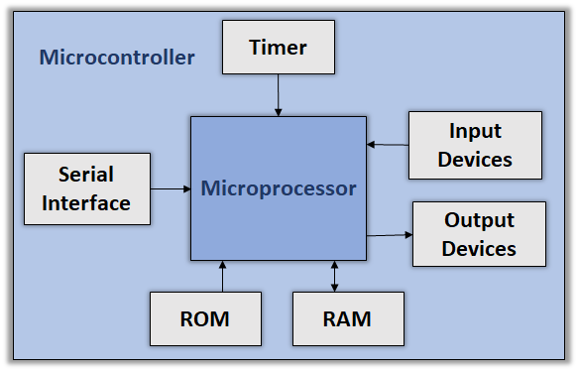
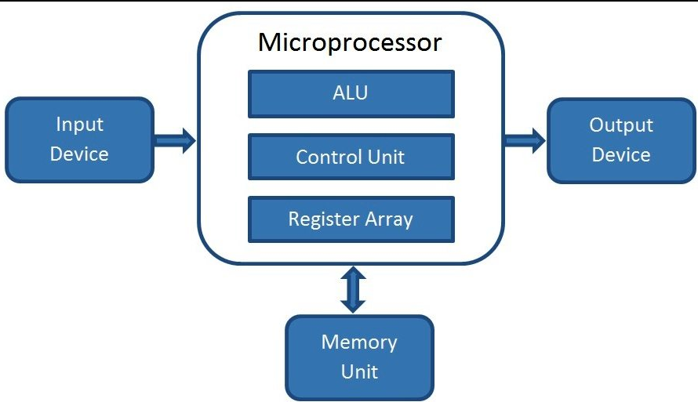
MCU vs MPU
Figure-architecture
Figure-architecture
Has ALU ,timing unit ,memory I/O port, timers, counters
Most of the pins are multifunctional
Low power consumption and cheaper
Has ALU and timing unit
Most of the pins are unifunctional
Higher power consumption and expensive
Figure-STM32f401
Figure-8086 mpu

Slide 39

STM32 vs Arduino
Arduino uses AVR-32 bit
Arduino have well-built libraries
Less processing speed
Can be programed directly through USB
Less use in industry, kids thing.
Figure-STM32F401
STM32 uses ARM-32b
Requires professional knowledge.
High processing speed
Can be programed through ST-Link
Huge use in industry
Figure-Arduino nano ATmega328p

Slide 40
Microcontrollers
Figure-11
Figure-10

Slide 41
Establish a network of microcontrollers based on network protocol (I2C/SPI/UART Communication)
Remotely connected microcontroller via server.
Further Goal: GUI based interface for better workings

Slide 42

Contents
Our presentation contains-
Objectives
Overview
What is Microcontroller
Microcontroller Evolution
Application of Microcontroller
Recent Market Trend
Trend in Microcontroller Market
Career in Microcontroller
STM32 Microcontroller
Project Lifetime
Goal
Limitations
Collaboration
Reference

Slide 43
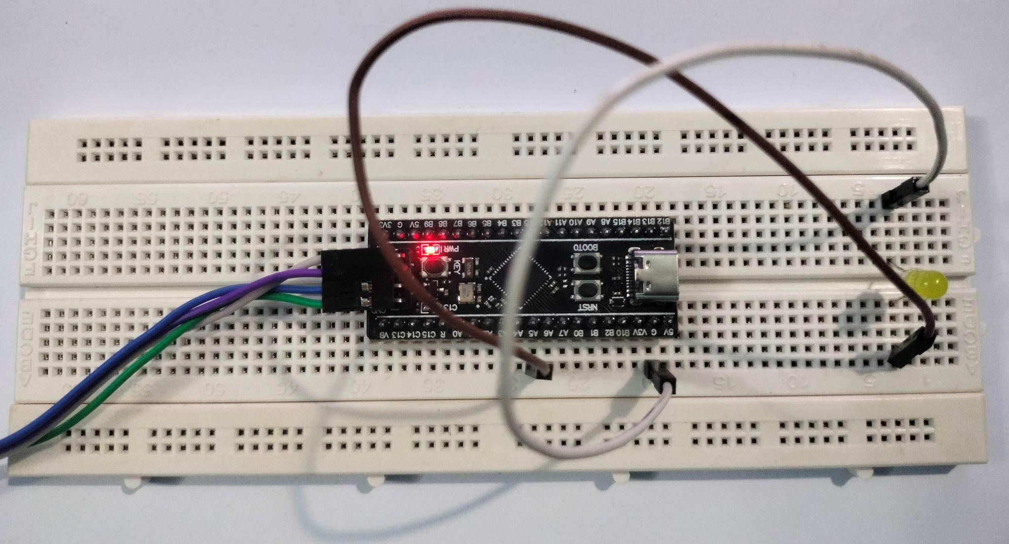
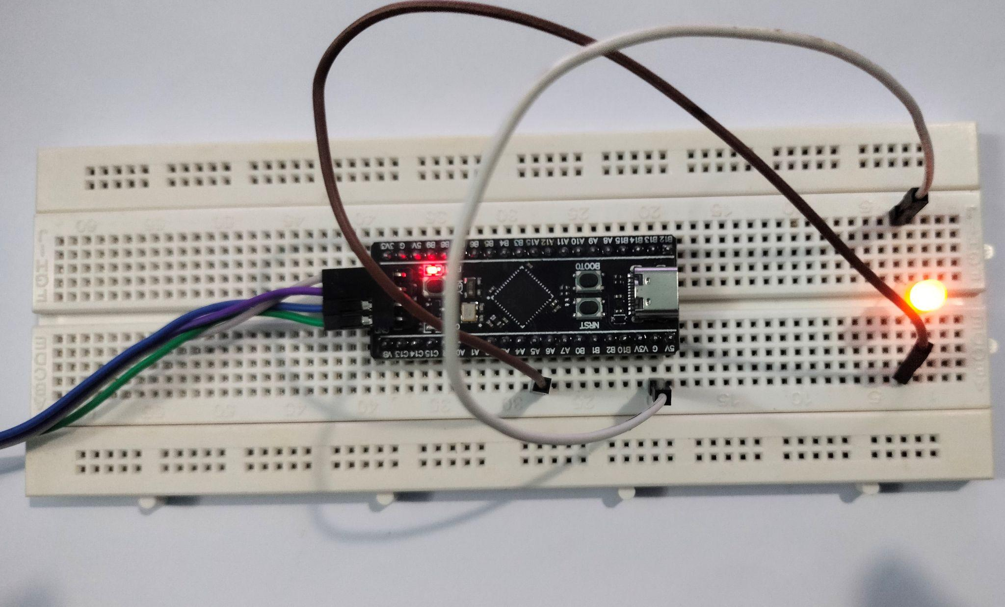
Achievements
We are already complete two initial tasks.
RCC Clock Configuration and LED Blinking
Timer configuration with precise delay

Slide 44
Achievements
Timer configuration with precise delay:

Slide 45
Achievements
Timer configuration with precise delay:

Slide 46
Goal
At the end of the project we will be able to do the followings
establish a network of microcontrollers based on network protocol (I2C/SPI/UART Communication)
remotely connected microcontroller via server.
Further Goal: GUI based interface for better workings

Slide 47
Limitations
Our project has some limitations such as
The big limitation of this project is resources.
Low-level C Programming.
Almost everything is manual working.
Official manual is huge and cumbersome.

Slide 48
Career in Microcontroller
Every year the usage of microcontroller is increasing which results in increasing the market size of microcontroller industry.
Figure-7
So, many many job opportunities is are created every year.
Figure-6

Slide 49
STM32 vs Arduino
Arduino uses AVR-32 bit
Arduino have well-built libraries
Less processing speed
Can be programed directly through USB
Less use in industry, kids thing.
Figure-STM32F401
STM32 uses ARM-32b
Requires professional knowledge.
High processing speed
Can be programed through ST-Link
Huge use in industry
Figure-Arduino nano ATmega328p

Slide 50


Dr. Shamim Ahmad
Professor
CSE, Rajshahi University
Md. Meem Mursalin
Chowdhury
ID: 1810276103
Md. Ashifujjman Rafi
ID: 1810376106
Md. Nahid Hassan
ID: 1710276139

